Slide 1


DATABASE MANAGEMENT SYSTEM
Sit Dolor Amet

Slide 2
PROJECT NAME: UBER DATABASE MANAGEMENT SYSTEM
Team of the Project:
1. B SIDDHARTHANATH
ROLL NUMBER: 21CSB0A08
GMAIL: bs21csb0a08@student.nitw.ac.in
2. ATKUR SAI CHARAN REDDY
ROLLNUMBER: 21CSB0A07
G-MAIL: as21csb0a07@student.nitw.ac.in

Slide 3
ABOUT THE PROJECT
The designed UBER DATABASE MANAGEMENT SYSTEM provides the data about:
Users who are registered on the Uber Application.
The Requests of all trips made by the users.
Details of the drivers working for the Uber and their respective vehicles.
Payment details of each trip that has been successfully completed.
Feedback of the user based on their trip experience.

Slide 4
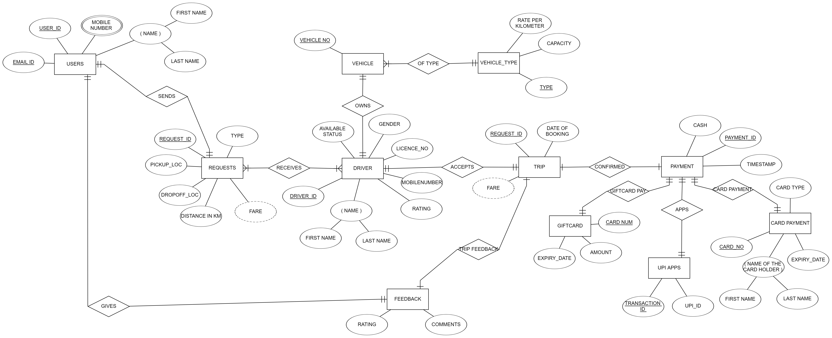
ENTITY RELATIONSHIP MODEL

Slide 5
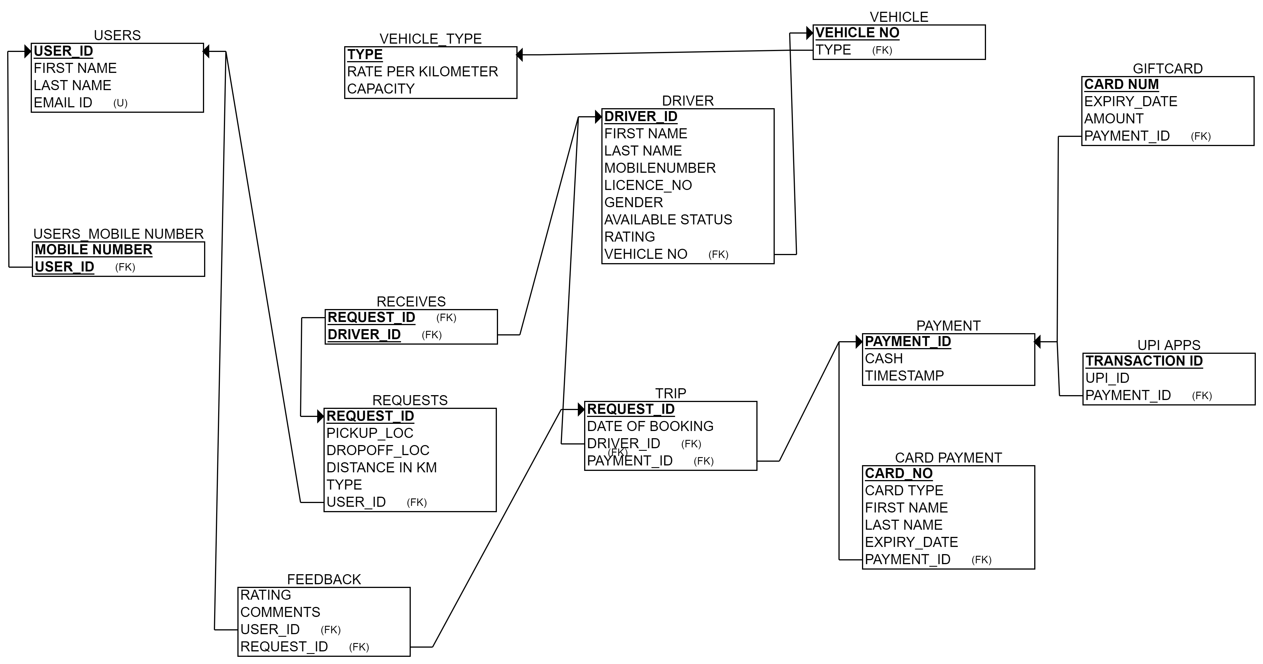
RELATION SCHEMA OF THE ER MODEL

Slide 6
ENTITIES
USER: User entity provides the data about who have registered in the UBER.
Attributes in the USER TABLE:
1. User_id (PRIMARY KEY)
2. First Name
3. Last Name
4. Email
USERS_PHN_NUMBER: This entity gives the contact details of the users.
Attributes in the USER_PHN_NUMBER:
1. User_id
2. Mobile_number
PRIMARY KEY(User_id, Mobile_number)
REQUESTS: Requests table provides all information about all the requests made by the different users for their respective trips.
Attributes in the REQUESTS TABLE:
1. Request_id (PRIMARY KEY)
2. Type of the vehicle
3. Pickup_Location
4. Dropoff_Location
5. User_id (FOREIGN KEY)

Slide 7
ENTITIES
DRIVER: Driver entity provides the data about all the drivers working with the UBER application. It also gives the availability status of a driver to book a vehicle.
Attributes in the DRIVER TABLE:
1. Driver_id (PRIMARY KEY)
2. First Name 3. Last Name
4. Mobile Number 5. License Number
6. Gender of the Driver 7. Availability Status
8. Rating 9. Vehicle_no (FOREIGN KEY)
VEHICLE: Vehicle table gives the data about the vehicle owned by the respective driver.
Attributes in the VEHICLE TABLE:
1.Vehicle_no (PRIMARY KEY)
2. Type of the vehicle
VEHICLE_TYPE: Vehicle type table gives the information about the capacity of the vehicle and the Rate of the vehicle per kilo meter.
Attributes in the VEHICLE TABLE:
1. Type of the vehicle (FOREIGN KEY)
2. Rate per kilometer
3. Capacity

Slide 8
ENTITIES
TRIP: Trip entity provides the data about driver who accepted the trip, date of booking, data about the request made by the user and the payment id of the trip.
Attributes in the TRIP TABLE:
1. Request_id (PRIMARY KEY)
2. Driver_id (FOREIGN KEY)
3. Payment_id (FOREIGN KEY)
4. Date of Booking
PAYMENT: Payment table provides information about the payment done for a particular trip and the date of payment.
Attributes in the PAYMENT TABLE:
1. Payment_id (PRIMARY KEY)
2. Cash
3. Date of Payment
UPI_APPS: It provides information about all the transactions that were done using UPI payment apps.
Attributes in the UPI_APPS TABLE:
1. Transaction_id (PRIMARY KEY)
2. UPI_ID
3. Payment_id (FOREIGN KEY)

Slide 9
ENTITIES
CARD_PAYMENT: Card payment entity provides information about all the transactions that were that using debit or credit cards.
Attributes in the CARD_PAYMENT TABLE:
1.CARD_NUM (PRIMARY KEY)
2. First Name
3. Last Name
4. Expiry_date
5. Payment_id (FOREIGN KEY)
GIFT_CARD: Giftcard table provides information about the payments that were made using the giftcards in the UBER application.
Attributes in the GIFT_CARD TABLE:
1. Card_no (PRIMARY KEY)
2. Amount in the card
3. Expiry_date
4. Payment_id (FOREIGN_KEY)
FEEDBACK: Feed back entity provides all the data of the feedbacks that were given by users based on their trip experience.
Attributes in the FEEDBACK TABLE:
1. Trip_id (FOREIGN KEY)
2. User_id (FOREIGN KEY)
3. Comments
4. Rating

Slide 10
FUNCTIONAL DEPENDENCIES AND NORMALISATION
USER TABLE:
Functional Dependencies:
1. USER_ID -> FIRSTNAME, LASTNAME, EMAIL
2. EMAIL -> USER_ID
Here, there are no partial and transitive dependencies and user_id is the primary key and email is the candidate or the super key. Hence it is in the BCNF.
USER_PHN_NUMBER TABLE:
Functional Dependencies:
1. (USER_ID, MOBILE_NUMBER )-> PRIMARY KEY
This functional dependency implies that the combination of user_id, mobile_number is unique for each row in the relation. This means that there can be no duplicate entries for the same user_id and mobile_number pair in the relation. It also ensures that the relation is in BCNF form by having all non-trivial functional dependencies on candidate keys.

Slide 11
FUNCTIONAL DEPENDENCIES AND NORMALISATION
REQUESTS TABLE:
Functional Dependencies:
1. REQUEST_ID -> PICKUP_LOC, DROPOFF_LOC, DISTANCE_IN_KM, TYPE, USER_ID
It is necessary to associate each request with the user who made the request, so it would be appropriate to include the USER_ID attribute in the REQUESTS table as a foreign key referencing the USER_ID attribute in the USERS table. As there is only one functional dependency in which REQUEST_ID is a PRIMARY KEY, confirms that there are no partial dependencies and transitive dependencies in the relation. Hence it is in BCNF.
VEHICLE TABLE:
Functional Dependencies:
1. VEHICLE_NO-> TYPE
This functional dependency implies that for each unique VEHICLE_NO, there is a unique type associated with it. Knowing the value of VEHICLE_NO is sufficient to determine the value of type. Hence it is in the BCNF.
VEHICLE_TYPE TABLE:
Functional Dependencies:
1.TYPE -> RATE_PER_KILOMETER, CAPACITY
This functional dependency implies that for each distinct TYPE of vehicle, there is a unique rate per kilometer and capacity associated with it. VEHICLE_TYPE only contains a single candidate key (the TYPE attribute), it is already in BCNF form and no further normalization is required.

Slide 12
FUNCTIONAL DEPENDENCIES AND NORMALISATION
DRIVER TABLE:
Functional Dependencies:
Driver_ID -> Firstname, Lastname, License_no, Gender, Mobile_number, Available_status_of_driver, Vehicle_no
License_no -> Driver_ID, Firstname, Lastname, Gender, Mobile_number, Available_status_of_driver, Vehicle_no
Mobile_number -> Driver_ID, Firstname, Lastname, Gender, License_no, Available_status_of_driver, Vehicle_no
Vehicle_no -> Driver_ID, Firstname, Lastname, Gender, License_no, Mobile_number, Available_status_of_driver
The Driver_ID attribute uniquely determines all other attributes in the relation, which implies that it is the primary key for the relation. The License_no attribute uniquely determines the values of all other attributes for a given driver, including the Driver_ID, firstname, lastname, gender, mobile number, available status, and vehicle number. This implies that no two drivers can have the same license number. The Mobile_number attribute also uniquely determines the values of all other attributes for a given driver, implying that no two drivers can have the same mobile number. The Vehicle_no attribute uniquely determines the values of all other attributes for a given driver, implying that no two drivers can have the same vehicle number. Note that these functional dependencies do not have any partial dependencies or transitive dependencies, which means that the relation is already in BCNF form.

Slide 13
FUNCTIONAL DEPENDENCIES AND NORMALISATION
TRIP TABLE:
Functional Dependencies:
REQUEST_ID -> {DRIVER_ID, PAYMENT_ID, DATE_OF_BOOKING}
This functional dependency implies that for each unique request_id, there is a unique set of values for driver_id, payment_id, and time of booking associated with it. It ensures that there are no partial and transitive dependencies in the relation. Hence it is in BCNF.
FEEDBACK TABLE:
Functional Dependencies:
request_id → user_id, rating, comments
Request_id determines the user who provided the feedback, the rating, and the comments for that request. The feedback relation is already in third normal form (3NF), which implies that it is also in Boyce-Codd normal form (BCNF). Therefore, no further decomposition is necessary to achieve BCNF.

Slide 14
FUNCTIONAL DEPENDENCIES AND NORMALISATION
PAYMENT TABLE:
Functional Dependencies:
1.Payment_id -> Cash, Date of payment.
This functional dependency implies that for each unique payment_id, there is a unique set of values for cash and payment_time associated with it. Knowing the value of payment_id is sufficient to determine the set of values for these attribute in the same row.
As there are no partial and transitive dependencies the relation is in BCNF.
CARD_PAYMENT TABLE:
Functional Dependencies:
1. Card_num ->Ccard_type, Expiry_date, Firstname, Lastname
The above functional dependency implies that for each unique card_num, there is a unique set of values for card_type, expiry_date, firstname, and lastname associated with it. As there are no partial and transitive dependencies the relation is in BCNF.

Slide 15
FUNCTIONAL DEPENDENCIES AND NORMALISATION
UPI_APPS TABLE:
Functional Dependencies:
Transaction_id-> Upi_id
The above functional dependency implies that for each unique transaction_id, there is a unique upi_id associated with it.
As there are no partial and transitive dependencies the relation is in BCNF.
GIFT_CARD TABLE:
Functional Dependencies:
1. Card_no -> Card_type, Expiry_date,Amount
The above functional dependency implies that for each unique card_num, there is a unique set of values for card_type, expiry_date, and amount associated with it .
As there are no partial and transitive dependencies the relation is in BCNF.Note that card_no is the primary key of the gift_card relation.

Slide 16
SQL CODE FOR CREATING AND INSERTING INTO USER TABLE
CREATE TABLE USERS(USER_ID VARCHAR(10) ,FIRST_NAME VARCHAR(20),LAST_NAMEVARCHAR(20),EMAIL_ID VARCHAR(30),PRIMARY KEY(USER_ID));
INSERT INTO USERS VALUES ('U00','SAI','CHARAN','charan@gmail.com');
INSERT INTO USERS VALUES ('U01','SIDHARTH','NATH','sid@gmail.com');
INSERT INTO USERS VALUES ('U02','AD','SACHIN','sachin@gmail.com');
INSERT INTO USERS VALUES ('U03','ANURAG','NAYAK','anurag@gmail.com');
INSERT INTO USERS VALUES ('U04','SHASHI','KUMAR','shashi@gmail.com');
INSERT INTO USERS VALUES ('U05','YESHWANTH','KUMAR','yeshu@gmail.com');
INSERT INTO USERS VALUES ('U06','MANOJ','HARSHA','manoj@gmail.com');
INSERT INTO USERS VALUES ('U07','SUPRAJ','PULLURU','supraj@gmail.com');
INSERT INTO USERS VALUES ('U08','RAHUL','VEMULA','rahul@gmail.com');
INSERT INTO USERS VALUES ('U09','PRANAY','SUHAS','pranay@gmail.com');
INSERT INTO USERS VALUES ('U10','VISHNU','VARDHAN','vishnu@gmail.com');
INSERT INTO USERS VALUES ('U11','ROHIT','SHARMA','rohit@gmail.com');
INSERT INTO USERS VALUES ('U12','AKASH','VARMA','akash@gmail.com');
INSERT INTO USERS VALUES ('U13','DEEPTHI','SHETTY','deepthi@gmail.com');
INSERT INTO USERS VALUES ('U14','POONITHA','REDDY','poonitha@gmail.com');
INSERT INTO USERS VALUES ('U15','SAI','VARSHA','varsha@gmail.com');
INSERT INTO USERS VALUES ('U16','SHIVANI','REDDY','shivani@gmail.com');
SELECT *
FROM USERS;

Slide 17
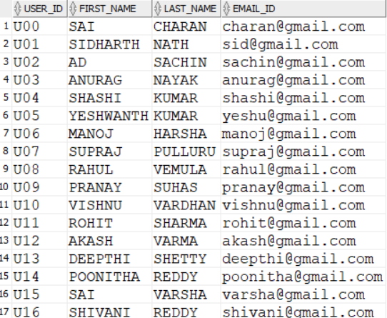
USER TABLE

Slide 18
SQL CODE FOR CREATING AND INSERTING INTO USERS_PHN_NUMBER TABLE
CREATE TABLE USERS_PHN_NUMBER(USER_ID VARCHAR(10),MOBILE_NUMBER INTEGER,PRIMARY KEY(USER_ID,MOBILE_NUMBER),FOREIGN KEY (USER_ID) REFERENCES USERS);
INSERT INTO USERS_PHN_NUMBER VALUES('U00',9392170417);INSERT INTO USERS_PHN_NUMBER VALUES ('U00',8074794434);
INSERT INTO USERS_PHN_NUMBER VALUES('U01',7492482625);INSERT INTO USERS_PHN_NUMBER VALUES ('U01',9854613794); INSERT INTO USERS_PHN_NUMBER VALUES ('U02',7654321098);INSERT INTO USERS_PHN_NUMBER VALUES('U02',9876543210);
INSERT INTO USERS_PHN_NUMBER VALUES('U03',9765432109);IINSERT INTO USERS_PHN_NUMBER VALUES('U03',7456789012); INSERT INTO USERS_PHN_NUMBER VALUES('U04',7432109876);INSERT INTO USERS_PHN_NUMBER VALUES('U04',9543210987); INSERT INTO USERS_PHN_NUMBER VALUES('U05',7543210987);INSERT INTO USERS_PHN_NUMBER VALUES('U05',9890123456); INSERT INTO USERS_PHN_NUMBER VALUES('U06',9321098765);INSERT INTO USERS_PHN_NUMBER VALUES('U06',8901234567); INSERT INTO USERS_PHN_NUMBER VALUES('U07',9210987654);INSERT INTO USERS_PHN_NUMBER VALUES('U07',9012345678); INSERT INTO USERS_PHN_NUMBER VALUES('U08',8109876543);INSERT INTO USERS_PHN_NUMBER VALUES('U08',7023456789); INSERT INTO USERS_PHN_NUMBER VALUES('U09',9876543210);INSERT INTO USERS_PHN_NUMBER VALUES('U09',9876543211); INSERT INTO USERS_PHN_NUMBER VALUES('U10',8765432109);INSERT INTO USERS_PHN_NUMBER VALUES('U10',8765432114); INSERT INTO USERS_PHN_NUMBER VALUES('U11',7654321098);INSERT INTO USERS_PHN_NUMBER VALUES('U11',7654327458); INSERT INTO USERS_PHN_NUMBER VALUES('U12',6543210987);INSERT INTO USERS_PHN_NUMBER VALUES('U12',9543214715); INSERT INTO USERS_PHN_NUMBER VALUES('U13',8452109876);INSERT INTO USERS_PHN_NUMBER VALUES('U13',9432109876); INSERT INTO USERS_PHN_NUMBER VALUES('U14',9321098765);INSERT INTO USERS_PHN_NUMBER VALUES('U14',9875098765); INSERT INTO USERS_PHN_NUMBER VALUES('U15',8654987654);INSERT INTO USERS_PHN_NUMBER VALUES('U15',9874127654); INSERT INTO USERS_PHN_NUMBER VALUES('U16',9109876543);INSERT INTO USERS_PHN_NUMBER VALUES('U16',9452876543);
SELECT *
FROM USERS;

Slide 19
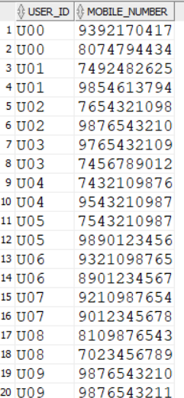
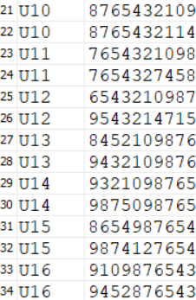
USERS_PHN_NUMBER TABLE

Slide 20
SQL CODE FOR CREATING AND INSERTING INTO REQUESTS TABLE
CREATE TABLE REQUESTS(REQUEST_ID VARCHAR(10), PICKUP_LOC VARCHAR(20), DROPOFF_LOC VARCHAR(20), DISTANCE_IN_KM FLOAT, TYPE VARCHAR(10),USER_ID VARCHAR(10), FARE FLOAT PRIMARY KEY(REQUEST_ID),FOREIGN KEY (USER_ID) REFERENCES USERS);
INSERT INTO REQUESTS VALUES('R01','UPPAL','LB NAGAR',10.2,'CAR','U01',0);
INSERT INTO REQUESTS VALUES('R02','HITECH CITY','ARAMGHAR',19.5,'CAR','U00',0);
INSERT INTO REQUESTS VALUES('R03','UPPAL','GACHIBOWLI',26.9,'CAR','U07',0);
INSERT INTO REQUESTS VALUES('R04','ALIPIRI','ANAMAYA CIRCLE',7.2,'CAR','U05',0);
INSERT INTO REQUESTS VALUES('R05','SECUNDERABAD','LB NAGAR',17.1,'BIKE','U10',0);
INSERT INTO REQUESTS VALUES('R06','MEHIDHIPATNAMAM','NARSINGI',10.9,'AUTO','U12',0);
INSERT INTO REQUESTS VALUES('R07','UPPAL','MEHIDHIPATNAM',20.3,'CAR','U03',0);
INSERT INTO REQUESTS VALUES('R08','AMEERPET','GACHI BOWLI',14.1,'AUTO','U16',0);
INSERT INTO REQUESTS VALUES('R09','KUKATPALLY','NECKLACE ROAD',16.4,'BIKE','U01',0);
INSERT INTO REQUESTS VALUES('R10','MADHAPUR','ABIDS',14.1,'BIKE','U11',0);
INSERT INTO REQUESTS VALUES('R11','KOTI','MEHIDHIPATNAM',7.5,'AUTO','U07',0);
INSERT INTO REQUESTS VALUES('R12','NAMPALLY','LAKDIKAPUL',2,'CAR','U04',0);
INSERT INTO REQUESTS VALUES('R13','HIMAYATHNAGAR','MIYAPUR',24,'AUTO','U08',0);
INSERT INTO REQUESTS VALUES('R14','KAIRATHABAD','GOLKONDA',10.2,'CAR','U06',0);
INSERT INTO REQUESTS VALUES('R15','PANJAGUTTA','ATTAPUR',8.9,'CAR','U09',0);
INSERT INTO REQUESTS VALUES('R16','UPPAL','CHARMINAR',12.7,'BIKE','U00',0);
INSERT INTO REQUESTS VALUES('R17','OSMAN NAGAR','CHARMINAR',43.1,'AUTO','U02',0);
INSERT INTO REQUESTS VALUES('R18','VANASTHALIPURAM','LB NAGAR',3.1,'CAR','U05',0);
INSERT INTO REQUESTS VALUES('R19','JUBILEE HILLS','LB NAGAR',24,'BIKE','U09',0);
INSERT INTO REQUESTS VALUES('R20','BANJARA HILLS','JUBILEE HILLS',5.6,'CAR','U12',0);
INSERT INTO REQUESTS VALUES('R21','UPPAL','PANJA GUTTA',16.6,'AUTO','U14',0);
INSERT INTO REQUESTS VALUES('R22','LB NAGAR','UPPAL',10.2,'CAR','U06',0);
INSERT INTO REQUESTS VALUES('R23','MIYAPUR','HIMAYATHNAGAR',24,'CAR','U10',0);
INSERT INTO REQUESTS VALUES('R24','LB NAGAR','SHAMSHABAD',22.1,'AUTO','U16',0);
INSERT INTO REQUESTS VALUES('R25','AMBERPET','RAMOJI FILM CITY',23,'CAR','U07',0);
SELECT * FROM REQUESTS;

Slide 21
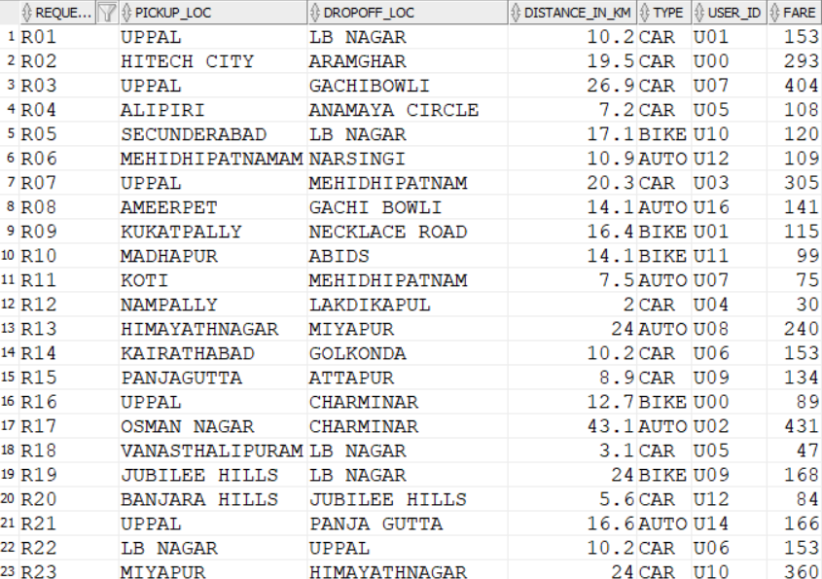
REQUESTS TABLE

Slide 22
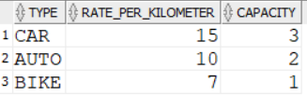
SQL CODE FOR CREATING AND INSERTING INTO VEHICLE TYPE TABLE
CREATE TABLE VEHICLE_TYPE(TYPE VARCHAR(10), RATE_PER_KILOMETER NUMERIC, CAPACITY INTEGER, PRIMARY KEY(TYPE));
INSERT INTO VEHICLE_TYPE VALUES('CAR',15,3);
INSERT INTO VEHICLE_TYPE VALUES('AUTO',10,2);
INSERT INTO VEHICLE_TYPE VALUES('BIKE',7,1);
SELECT *
FROM VEHICLE_TYPE;
VEHICLE TYPE TABLE

Slide 23
SQL CODE FOR CREATING AND INSERTING INTO VEHICLE TABLE
CREATE TABLE VEHICLE(VEHICLE_ID VARCHAR(20), TYPE VARCHAR(10), PRIMARY KEY (VEHICLE_ID), FOREIGN KEY (TYPE) REFERENCES VEHICLE_TYPE);
INSERT INTO VEHICLE VALUES('TS 06 EB 4835','CAR');
INSERT INTO VEHICLE VALUES('TS 07 ES 7485','CAR');
INSERT INTO VEHICLE VALUES('TS 08 AK 1947','AUTO');
INSERT INTO VEHICLE VALUES('AP 07 KS 4875','AUTO');
INSERT INTO VEHICLE VALUES('AP 05 ED 7548','BIKE');
INSERT INTO VEHICLE VALUES('TS 09 AS 1234','BIKE');
INSERT INTO VEHICLE VALUES('AP 09 QW 9874','CAR');
SELECT * FROM VEHICLE;

Slide 24
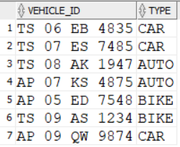
VEHICLE TABLE

Slide 25
SQL CODE FOR CREATING AND INSERTING INTO DRIVER TABLE
CREATE TABLE DRIVER(DRIVER_ID VARCHAR(10), FIRST_NAME VARCHAR(10), LAST_NAME VARCHAR(10), GENDER VARCHAR(1), AVAILABLE_STATUS INTEGER, LICENCE_NUMBER VARCHAR(20), MOBILE_NUMBER INTEGER, RATING FLOAT, VEHICLE_NUMBER VARCHAR(20), PRIMARY KEY (DRIVER_ID));
INSERT INTO DRIVER VALUES('D01','RAMESH','KUMAR','M',1,'TS03820220004450',7845912345,0,'TS 06 EB 4835');
INSERT INTO DRIVER VALUES('D02','AMIT','Sharma','M',1,'TS01234567891200',9876543210,0,'TS 07 ES 7485');
INSERT INTO DRIVER VALUES('D03','NEHA','SINGH','F',1,'TS98765432109800',8765432109,0,'TS 08 AK 1947');
INSERT INTO DRIVER VALUES('D04','RAJESH','GOUD','M',0,'TS87654321098700',7654321098,0,'AP 07 KS 4875');
INSERT INTO DRIVER VALUES('D05','PRIYANKA','KULKARNI','F',1,'TS76543210987600',9543210987,0,'AP 05 ED 7548');
INSERT INTO DRIVER VALUES('D06','VIKRAM','SINGH','M',0,'TS65432109876500',9432109876,0,'TS 09 AS 1234');
INSERT INTO DRIVER VALUES('D07','ARUN','KUMAR','M',1,'TS54321098765400',9321098765,0,'AP 09 QW 9874');
SELECT * FROM DRIVER;
SELECT AVG(RATING)
FROM (SELECT * FROM FEEDBACK
NATURAL JOIN TRIP)
GROUP BY DRIVER_ID;
UPDATE DRIVER
SET RATING=(SELECT AVG(RATING)
FROM (SELECT * FROM FEEDBACK NATURAL JOIN TRIP)
GROUP BY DRIVER_ID HAVING DRIVER_ID='D07')
WHERE DRIVER_ID='D07’;
SELECT * FROM DRIVER;

Slide 26
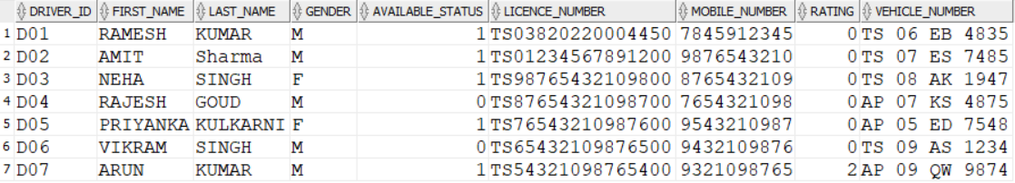
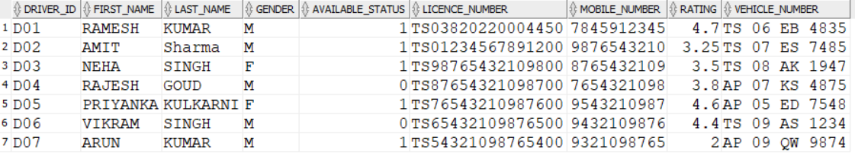
DRIVER TABLE

Slide 27
SQL CODE FOR CREATING AND INSERTING INTO TRIP TABLE
CREATE TABLE TRIP(REQUEST_ID VARCHAR(10), DRIVER_ID VARCHAR(10), PAYMENT_ID VARCHAR(10), DATE_OD_BOOKING DATE, FARE FLOAT, PRIMARY KEY (REQUEST_ID), FOREIGN KEY(REQUEST_ID) REFERENCES REQUESTS, FOREIGN KEY(DRIVER_ID) REFERENCES DRIVER);
INSERT INTO TRIP VALUES('R01','D01','P01','02 JAN 2022',153);
INSERT INTO TRIP VALUES('R02','D02','P02','03 JAN 2022',293);
INSERT INTO TRIP VALUES('R03','D07','P03','05 JAN 2022',404);
INSERT INTO TRIP VALUES('R04','D01','P04','06 JAN 2022',108);
INSERT INTO TRIP VALUES('R05','D05','P05','08 JAN 2022',120);
INSERT INTO TRIP VALUES('R06','D03','P06','08 JAN 2022',109);
INSERT INTO TRIP VALUES('R07','D02','P07','08 JAN 2022',305);
INSERT INTO TRIP VALUES('R08','D04','P08','12 JAN 2022',141);
INSERT INTO TRIP VALUES('R09','D06','P09','14 JAN 2022',115);
INSERT INTO TRIP VALUES('R10','D05','P10','14 JAN 2022',99);
INSERT INTO TRIP VALUES('R11','D03','P11','17 JAN 2022',75);
INSERT INTO TRIP VALUES('R12','D07','P12','18 JAN 2022',30);
INSERT INTO TRIP VALUES('R13','D04','P13','20 JAN 2022',240);
INSERT INTO TRIP VALUES('R14','D01','P14','20 JAN 2022',153);
INSERT INTO TRIP VALUES('R15','D07','P15','23 JAN 2022',134);
SELECT * FROM TRIP;

Slide 28
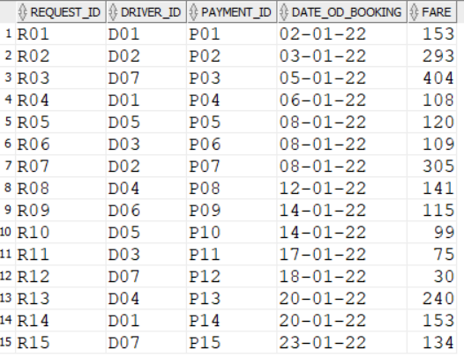
TRIP TABLE

Slide 29
SQL CODE FOR CREATING AND INSERTING INTO FEEDBACK TABLE
CREATE TABLE FEEDBACK(REQUEST_ID VARCHAR(10), USER_ID VARCHAR(10), RATING FLOAT, COMMENTS VARCHAR(200), PRIMARY KEY(REQUEST_ID), FOREIGN KEY(REQUEST_ID) REFERENCES TRIP, FOREIGN KEY(USER_ID) REFERENCES USERS);
INSERT INTO FEEDBACK VALUES('R01','U01',4.5,'GOOD');
INSERT INTO FEEDBACK VALUES('R02','U00',4,'GOOD');
INSERT INTO FEEDBACK VALUES('R03','U07',2,'BAD');
INSERT INTO FEEDBACK VALUES('R04','U05',4.9,'GOOD');
INSERT INTO FEEDBACK VALUES('R05','U10',4.5,'GOOD');
INSERT INTO FEEDBACK VALUES('R06','U12',3.5,'AVERAGE');
INSERT INTO FEEDBACK VALUES('R07','U03',2.5,'TIME DELAY');
INSERT INTO FEEDBACK VALUES('R08','U16',3.8,'BETTER');
INSERT INTO FEEDBACK VALUES('R09','U01',4.4,'GOOD DRIVING');
INSERT INTO FEEDBACK VALUES('R10','U11',4.7,'GOOD');
SELECT * FROM FEEDBACK;

Slide 30
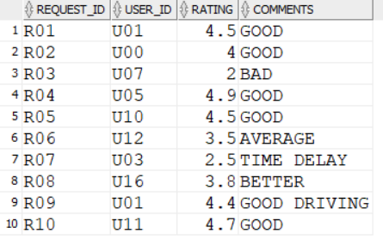
FEEDBACK TABLE

Slide 31
SQL CODE FOR CREATING AND INSERTING INTO PAYMENT TABLE
CREATE TABLE PAYMENT( PAYMENT_ID VARCHAR(20), CASH INT, REQUEST_ID VARCHAR(10), TIME_OF_PAYMENT DATE, PRIMARY KEY(PAYMENT_ID), FOREIGN KEY(REQUEST_ID) REFERENCES TRIP);
INSERT INTO PAYMENT VALUES('P01', 0, 'R01','02-JAN-2022');
INSERT INTO PAYMENT VALUES('P02', 1, 'R02','03-JAN-2022');
INSERT INTO PAYMENT VALUES('P03', 0, 'R03','05-JAN-2022');
INSERT INTO PAYMENT VALUES('P04', 1, 'R04','06-JAN-2022');
INSERT INTO PAYMENT VALUES('P05', 0, 'R05','08-JAN-2022');
INSERT INTO PAYMENT VALUES('P06', 1, 'R06','08-JAN-2022');
INSERT INTO PAYMENT VALUES('P07', 0, 'R07','08-JAN-2022');
INSERT INTO PAYMENT VALUES('P08', 1, 'R08','12-JAN-2022');
INSERT INTO PAYMENT VALUES('P09', 0, 'R09','14-JAN-2022');
INSERT INTO PAYMENT VALUES('P10', 1, 'R10','14-JAN-2022');
INSERT INTO PAYMENT VALUES('P11', 1, 'R11','17-JAN-2022');
INSERT INTO PAYMENT VALUES('P12', 1, 'R12','18-JAN-2022');
INSERT INTO PAYMENT VALUES('P13', 0, 'R13','20-JAN-2022');
INSERT INTO PAYMENT VALUES('P14', 1, 'R14','20-JAN-2022');
INSERT INTO PAYMENT VALUES('P15', 0, 'R15','23-JAN-2022');
SELECT *
FROM PAYMENT;

Slide 32
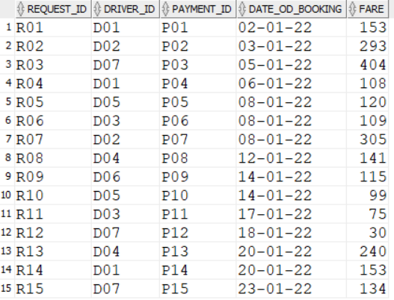
PAYMENT TABLE

Slide 33
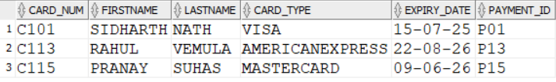
SQL CODE FOR CREATING AND INSERTING INTO CARD_PAYMENT TABLE
CREATE TABLE CARD_PAYMENT(CARD_NUM VARCHAR(10), FIRSTNAME VARCHAR(20),CARD_TYPE VARCHAR(20),LASTNAME VARCHAR(20), EXPIRY_DATE DATE, PAYMENT_ID VARCHAR(20), PRIMARY KEY (CARD_NUM), FOREIGN KEY(PAYMENT_ID) REFERENCES PAYMENT);
INSERT INTO CARD_PAYMENT VALUES('C101','SIDHARTH','NATH’,’VISA’,'15-07-2025','P01');
INSERT INTO CARD_PAYMENT VALUES('C113','RAHUL','VEMULA’,’AMERICAN EXPRESS’,'22-08-2026','P13');
INSERT INTO CARD_PAYMENT VALUES('C115','PRANAY','SUHAS’,’MASTERCARD’,'09-06-2026','P15');
SELECT *
FROM CARD_PAYMENT;
CARD_PAYMENT TABLE

Slide 34
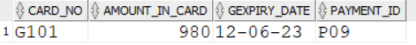
SQL CODE FOR CREATING AND INSERTING INTO GIFT_CARD TABLE
CREATE TABLE GIFT_CARD( CARD_NO VARCHAR(10), AMOUNT_IN_CARD NUMERIC, GEXPIRY_DATE DATE, PAYMENT_ID VARCHAR(20), PRIMARY KEY(CARD_NO), FOREIGN KEY(PAYMENT_ID) REFERENCES PAYMENT);
INSERT INTO GIFT_CARD VALUES('G101',980,'12-06-2023','P09’);
SELECT *
FROM GIFT_CARD;
GIFT_CARD TABLE

Slide 35
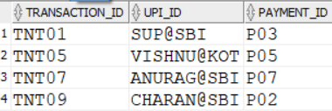
SQL CODE FOR CREATING AND INSERTING INTO UPI_APPS TABLE
CREATE TABLE UPI_APPS(TRANSACTION_ID VARCHAR(20), UPI_ID VARCHAR(10), PAYMENT_ID VARCHAR(20), PRIMARY KEY(TRANSACTION_ID), FOREIGN KEY(PAYMENT_ID) REFERENCES PAYMENT);
SELECT *
FROM UPI_APPS;
INSERT INTO UPI_APPS VALUES('TNT01','SUP@SBI','P03');
INSERT INTO UPI_APPS VALUES('TNT05','VISHNU@KOT','P05');
INSERT INTO UPI_APPS VALUES('TNT07','ANURAG@SBI','P07');
INSERT INTO UPI_APPS VALUES('TNT09','CHARAN@SBI','P02');
UPI_APPS TABLE

Slide 36
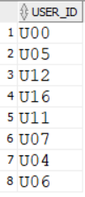
SQL QUERIES
List out the users who have made payment on cash mode.
SQL QUERY:
SELECT USER_ID
FROM REQUESTS NATURAL JOIN (SELECT *
FROM PAYMENT NATURAL JOIN TRIP
WHERE CASH=1);
OUTPUT:

Slide 37
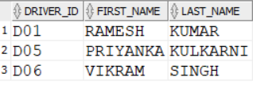
SQL QUERIES
List out the drivers who have rating above 4.
SQL QUERY:
SELECT DRIVER_ID,FIRST_NAME,LAST_NAME
FROM DRIVER
WHERE RATING>4
OUTPUT:

Slide 38
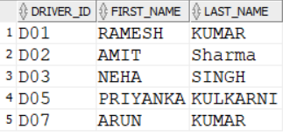
SQL QUERIES
At the moment which driver is available for booking.
SQL QUERY:
SELECT DRIVER_ID,FIRST_NAME,LAST_NAME
FROM DRIVER
WHERE AVAILABLE_STATUS=1;
OUTPUT:

Slide 39
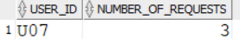
SQL QUERIES
List out the users who have requested trip for most of the times.
SQL QUERY:
SELECT USER_ID,X AS NUMBER_OF_REQUESTS
FROM (SELECT COUNT(USER_ID) AS X,USER_ID
FROM REQUESTS
GROUP BY USER_ID)
WHERE X=(SELECT MAX(COUNT(USER_ID))
FROM REQUESTS
GROUP BY USER_ID);
OUTPUT:

Slide 40
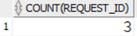
SQL QUERIES
How many trips are done on the date 08-JAN-2022.
SQL QUERY:
SELECT COUNT(REQUEST_ID)
FROM TRIP
WHERE DATE_OD_BOOKING='08 JAN 2022’
OUTPUT:

Slide 41
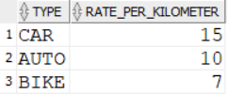
SQL QUERIES
What is the Rate per kilo meter of each vehicle in uber.
SQL QUERY:
SELECT TYPE,RATE_PER_KILOMETER
FROM VEHICLE_TYPE;
OUTPUT:

Slide 42
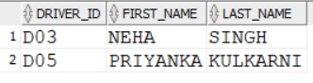
SQL QUERIES
List out the female drivers in the Uber database.
SQL QUERY:
SELECT DRIVER_ID,FIRST_NAME,LAST_NAME
FROM DRIVER
WHERE GENDER=‘F’;
OUTPUT:

Slide 43
THE END

Slide 44
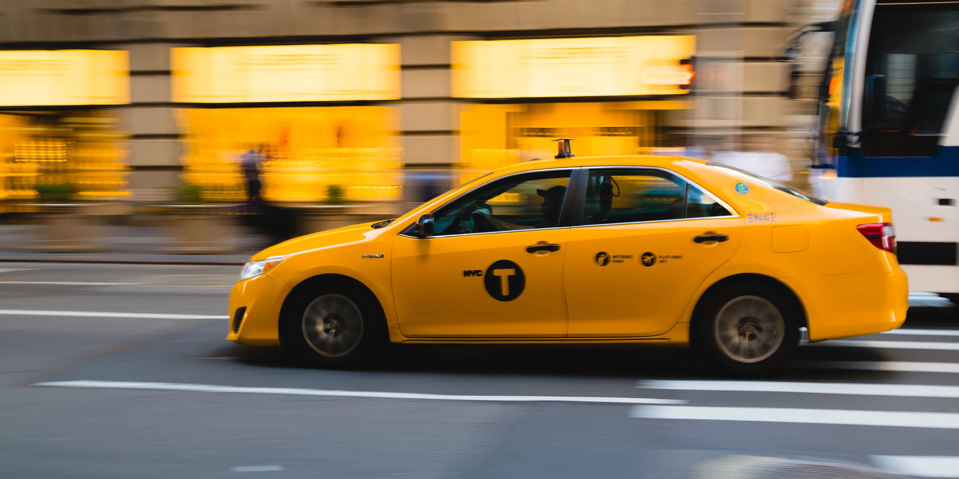
THANK YOU!!

